Slide 1


Slide 2
Computational approaches for the therapeutic target discovery to ame-liorate muscle wasting during aging and disease
Msc Karen Guerrero Vazquez
Dr. Katarzyna Whysall
Dr. Pilib O Broin

Slide 3
Table of contents
Introduction to the problem
Objective of the project
Differential expression analysis
New database to easer access to microRNA information
Network analysis
Future work

Slide 4
The problem…
1

Slide 5

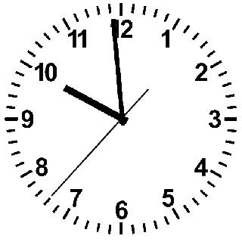
1

Slide 6
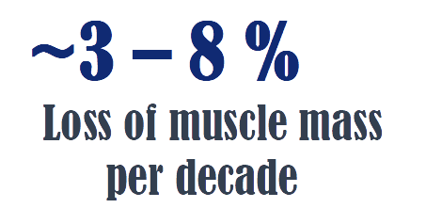
1

Slide 7
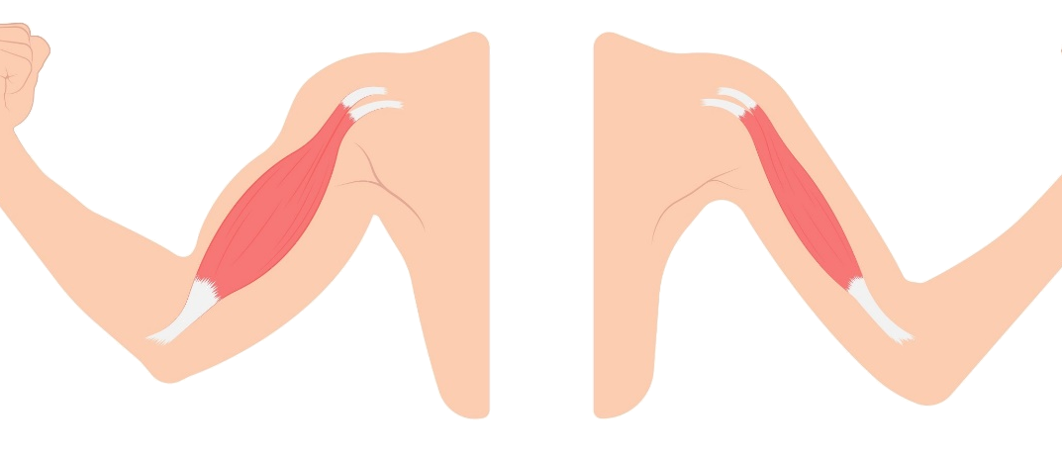
1

Slide 8
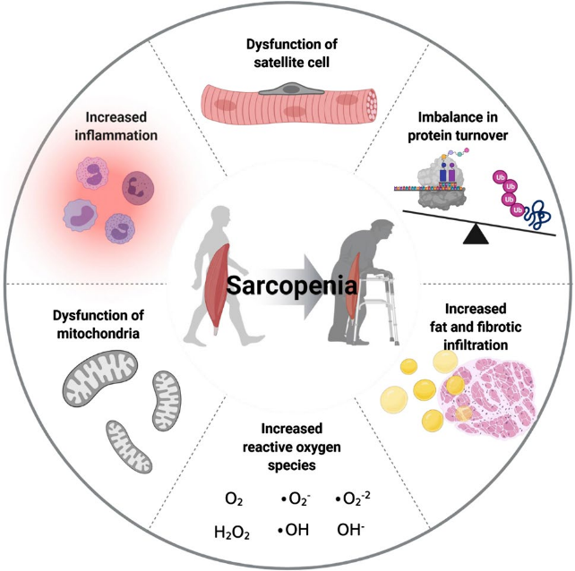
1

Slide 9
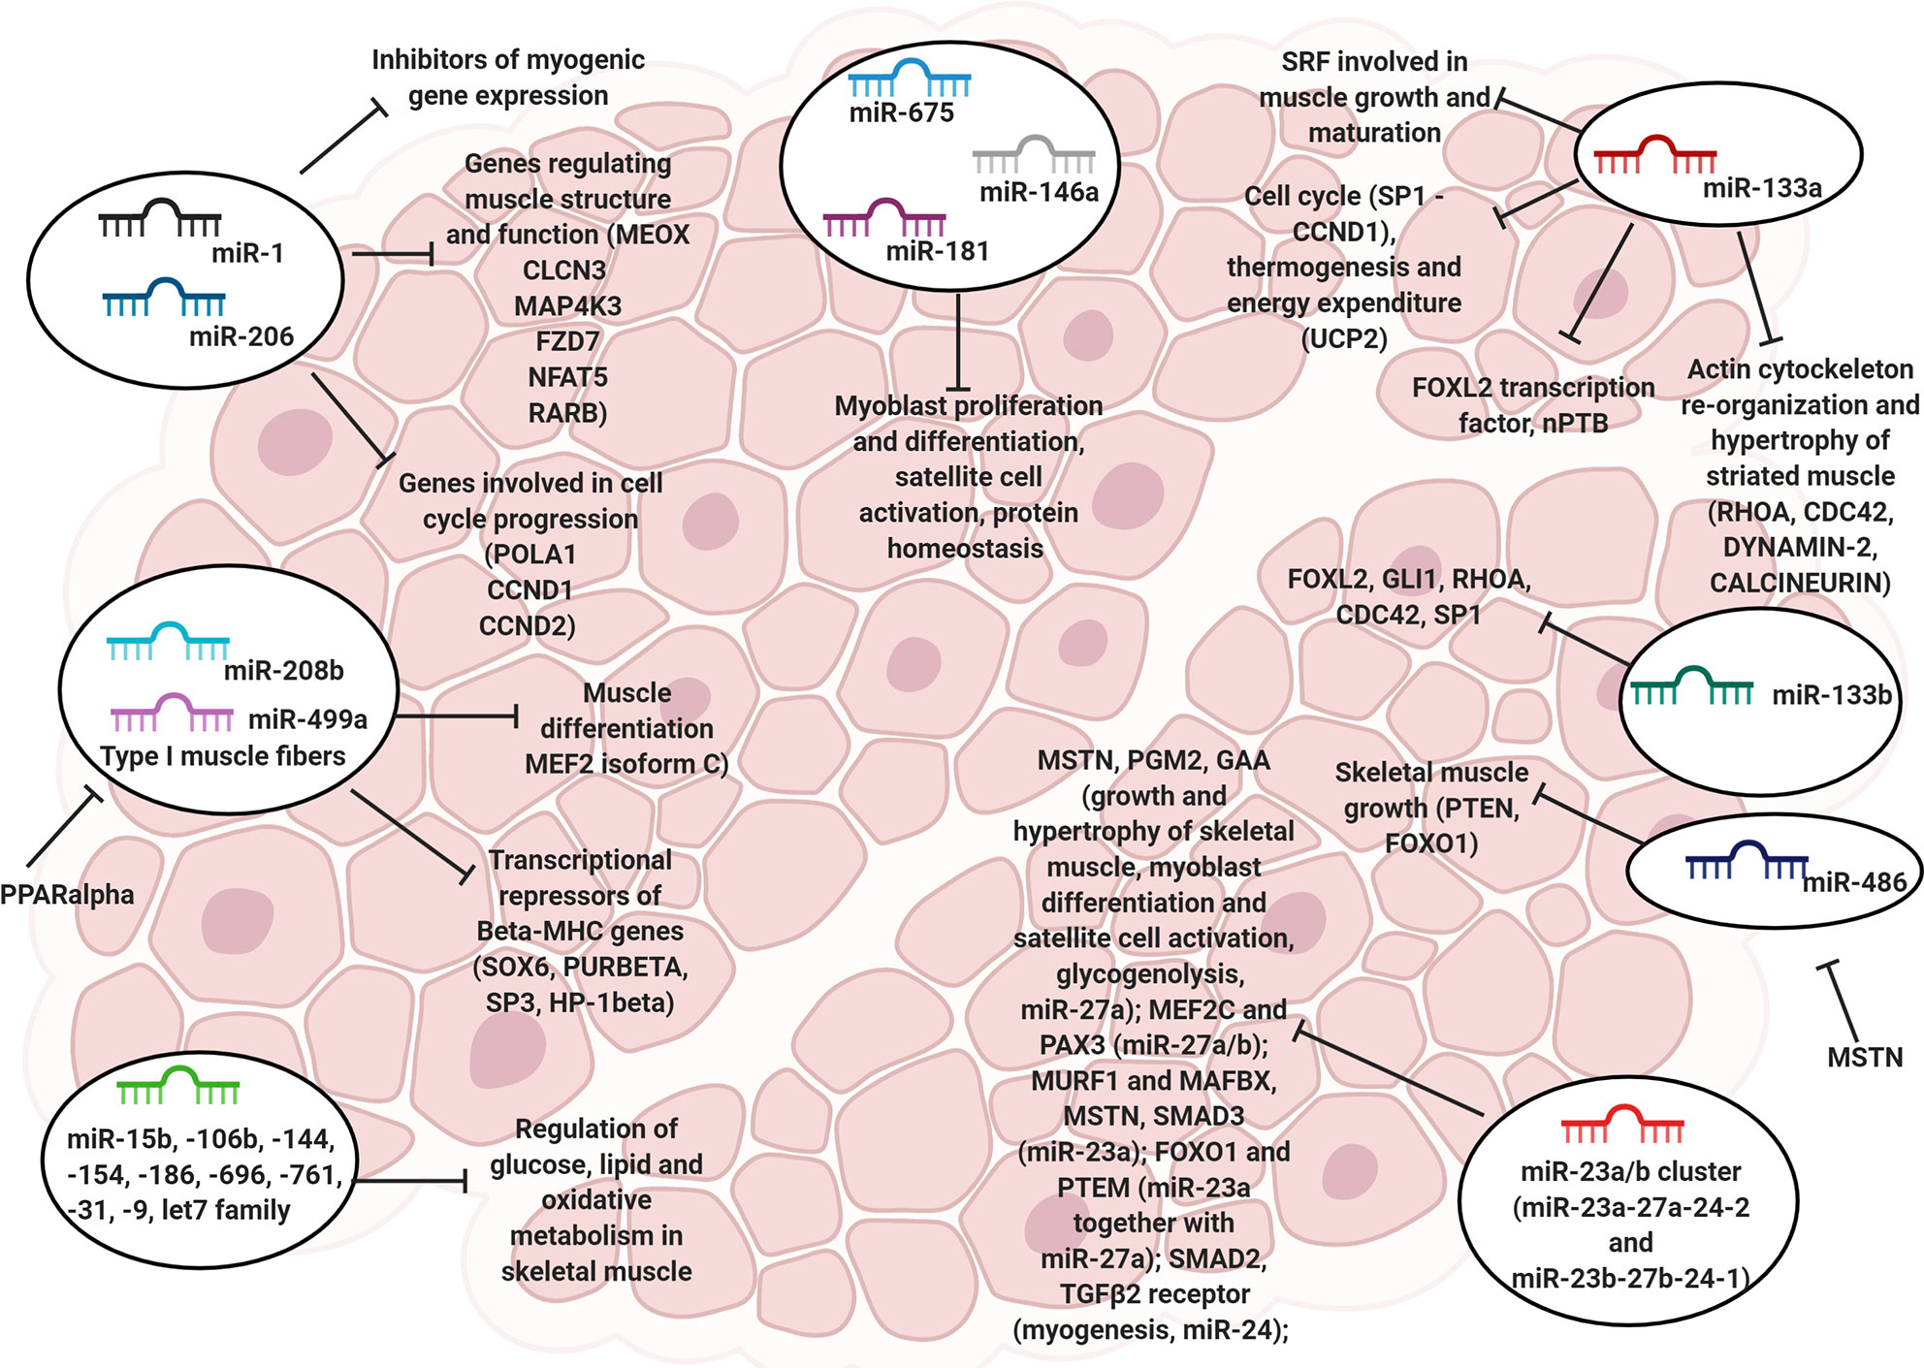

MicroRNA (miRNAs)
1

Slide 10
By random, every microRNA should hit them all
1
~1200 nt
mRNA
~22 nt
miRNA
seed
91%
~8 nt
Random miRNA hit random mRNA

Slide 11
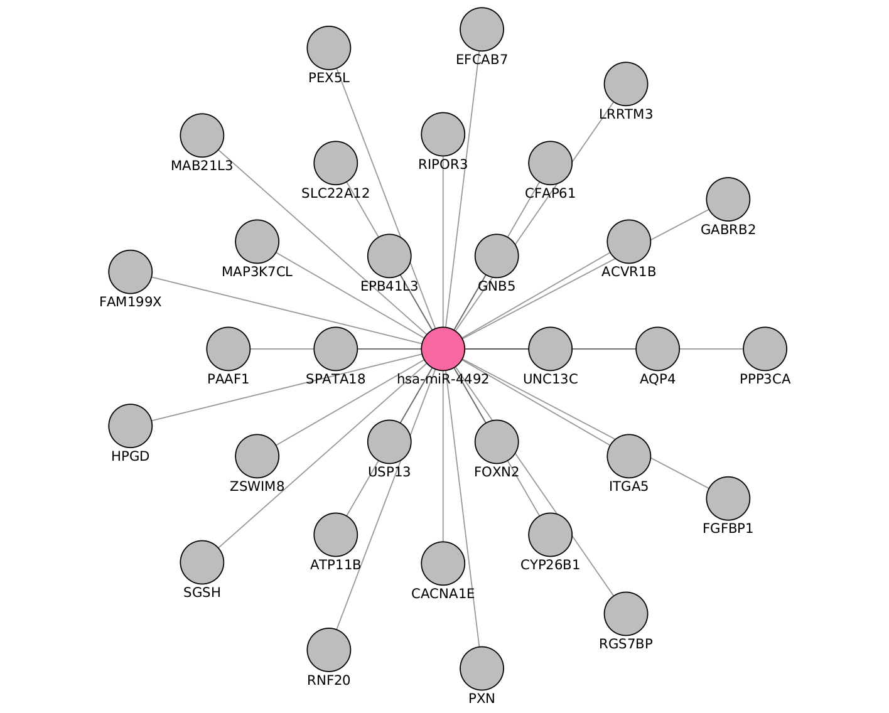
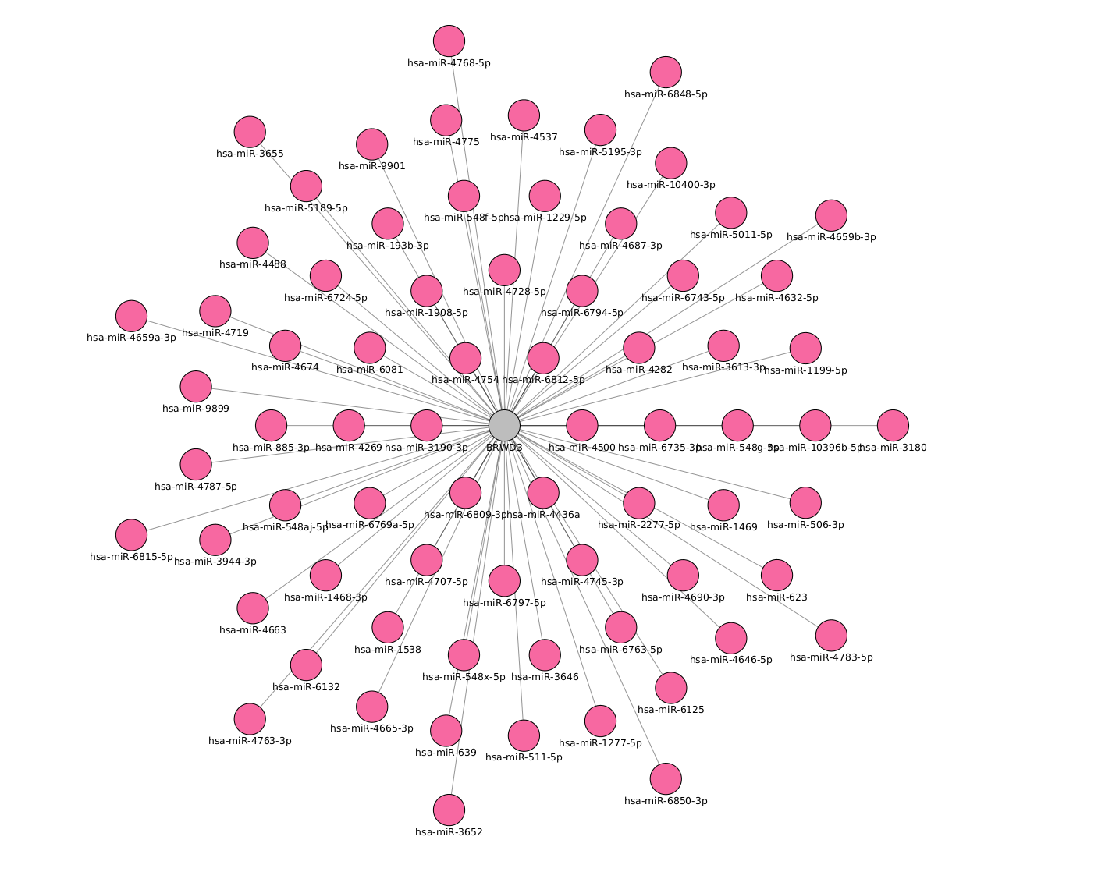
Many to many
1

Slide 12
Objective
2

Slide 13
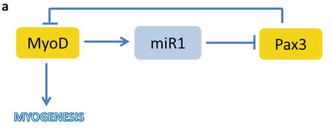
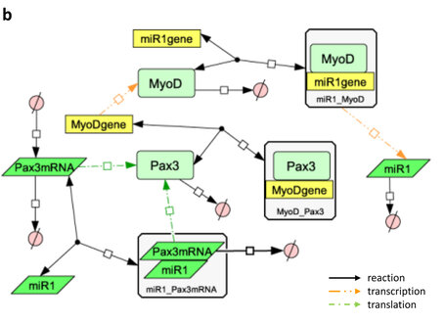
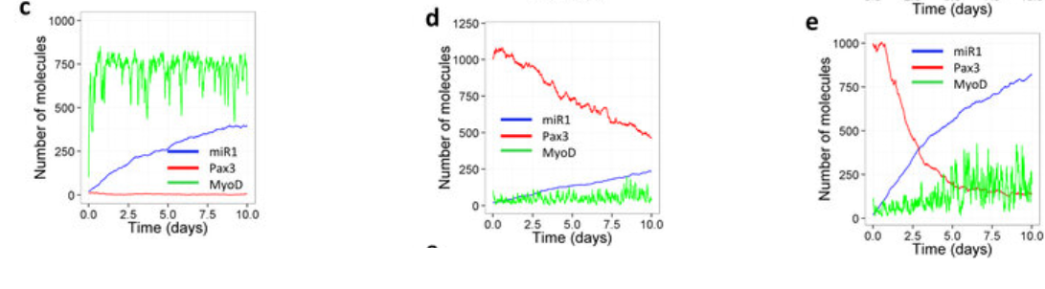
2

Slide 14
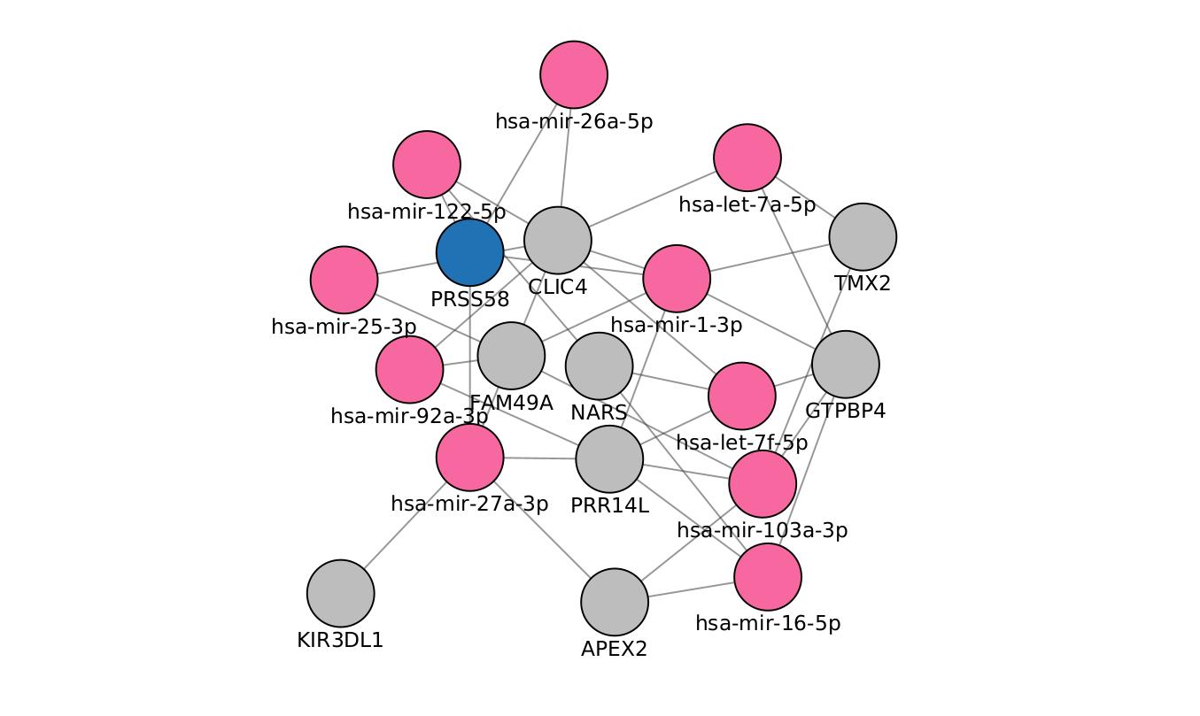
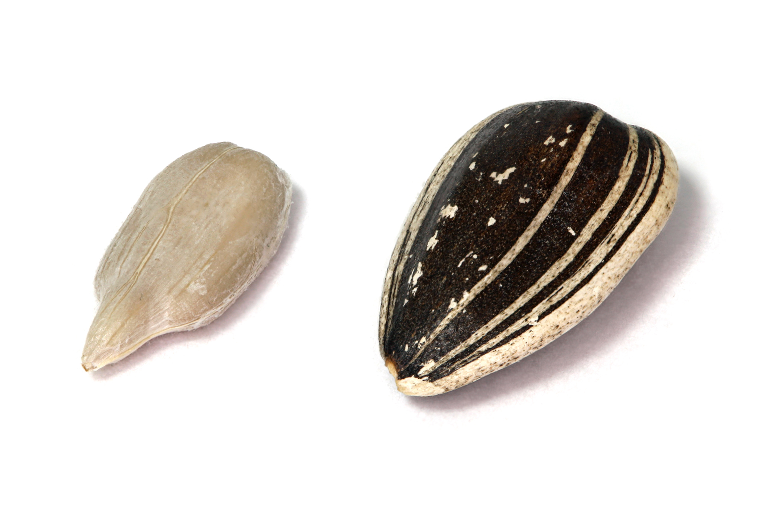
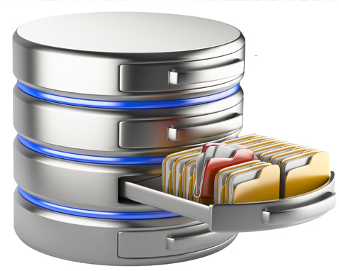
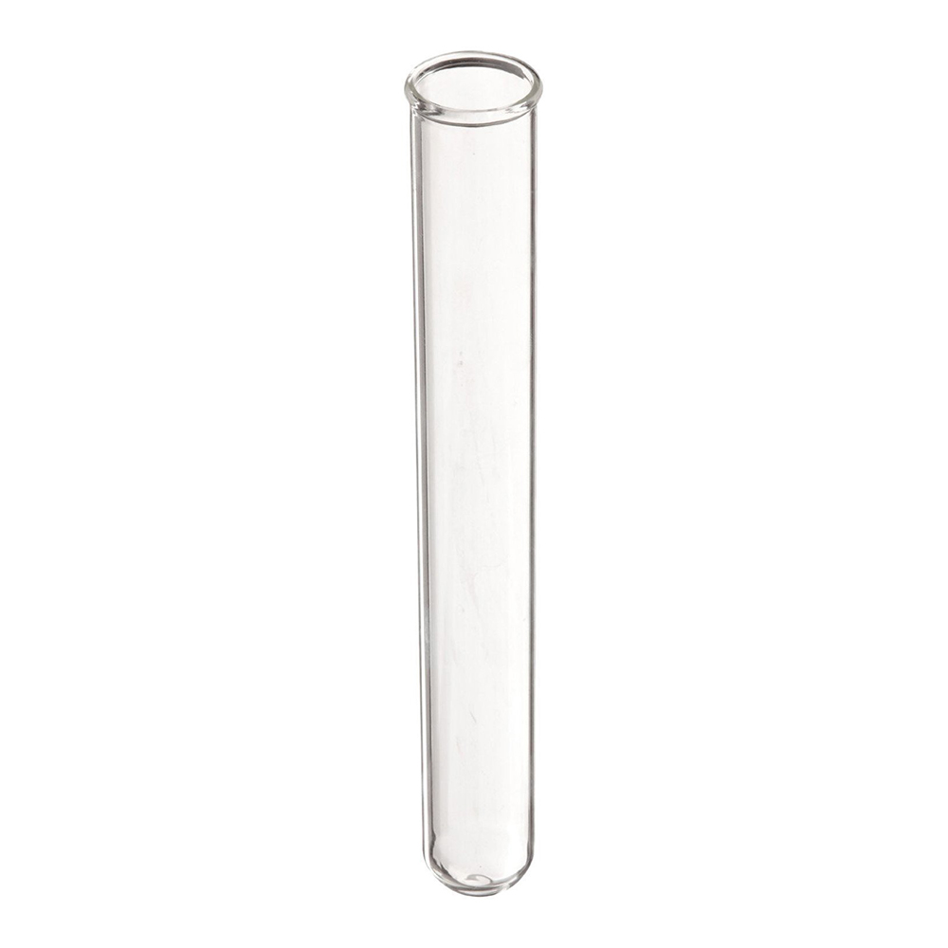

What are we going to do to archive this goal?
2
Model
Seed
Network
Experimental validation
Database
Genes
Notes:
Creation a seed or genes
Recompile the microRNA metadata on a practical accessible way
Integrate the microRNA data with the genes
Select the gene and microRNA players
Generate the model with selected genes and microRNA
Validation

Slide 15
Differential expression analysis
3

Slide 16
Experiments collected
3
Target | Type | n. Experiments | Healty | non-healty
mRNA | RNASeq | 3 | 3 | 0
 | MicroArray | 4 | 2 | 2
miRNA | MicroArray | 2 | 2 | 0
 | miRSeq | 1 | 0 | 1

Slide 17
Experiments
3
GEO number | Samples | Min Age | Max Age | Reference
GSE152558 | 5 | 41 | 85 | Tharakan, R., Ubaida-Mohien, C., Piao, Y., Gorospe, M., & Ferrucci, L. (2021).
GSE164471 | 53 | 34 | 80 | Tumasian III, R. A., Harish, A., Kundu, G., Yang, J. H., Ubaida-Mohien, C., Gonzalez-Freire, M., ... & Ferrucci, L. (2021).
GSE157585 | 136 | 19 | >65 | Kulkarni, A. S., Peck, B. D., Walton, R. G., Kern, P. A., Mar, J. C., Windham, S. T., ... & Peterson, C. A. (2020).
GSE87105 | 16 | 30 | 78 | Mercken, E. M., Capri, M., Carboneau, B. A., Conte, M., Heidler, J., Santoro, A., ... & de Cabo, R. (2017)..

Slide 18
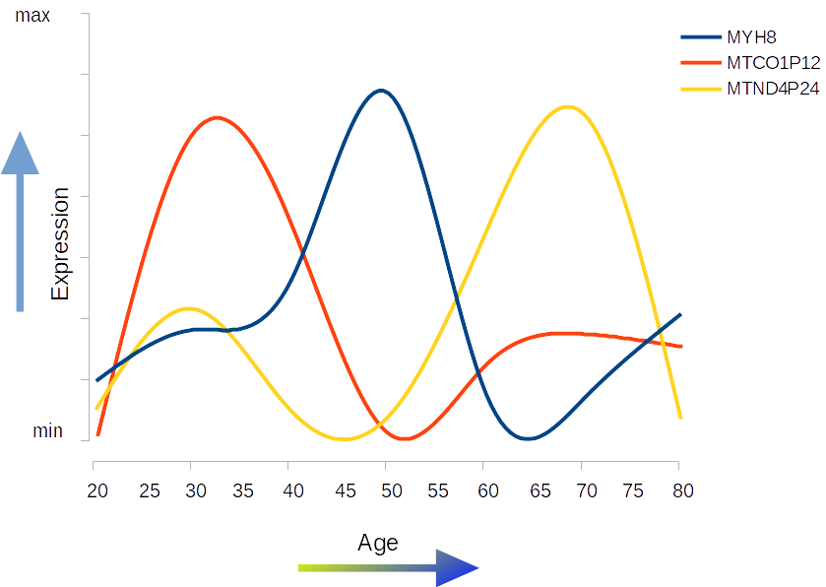



3

Slide 19
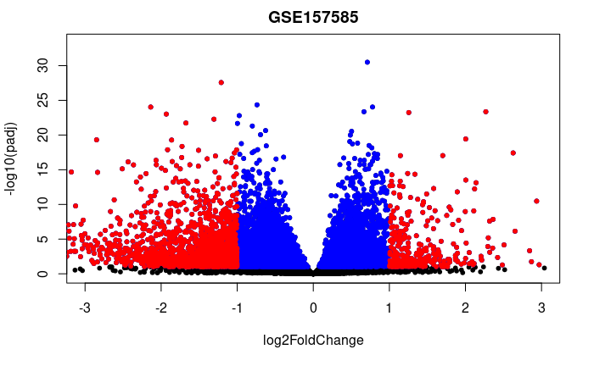
Differential expression
3
Quality evaluation: FastQC
Trimming adapters: cutadapt
Pseudo alignment: Kallisto
Mapping to Ensemble: GRCh38.p13
Differential expression: DESeq2
Pathway analysis: gseapy
Adjusted P-value: 0.1
Log-Fold Change: 1.0

Slide 20
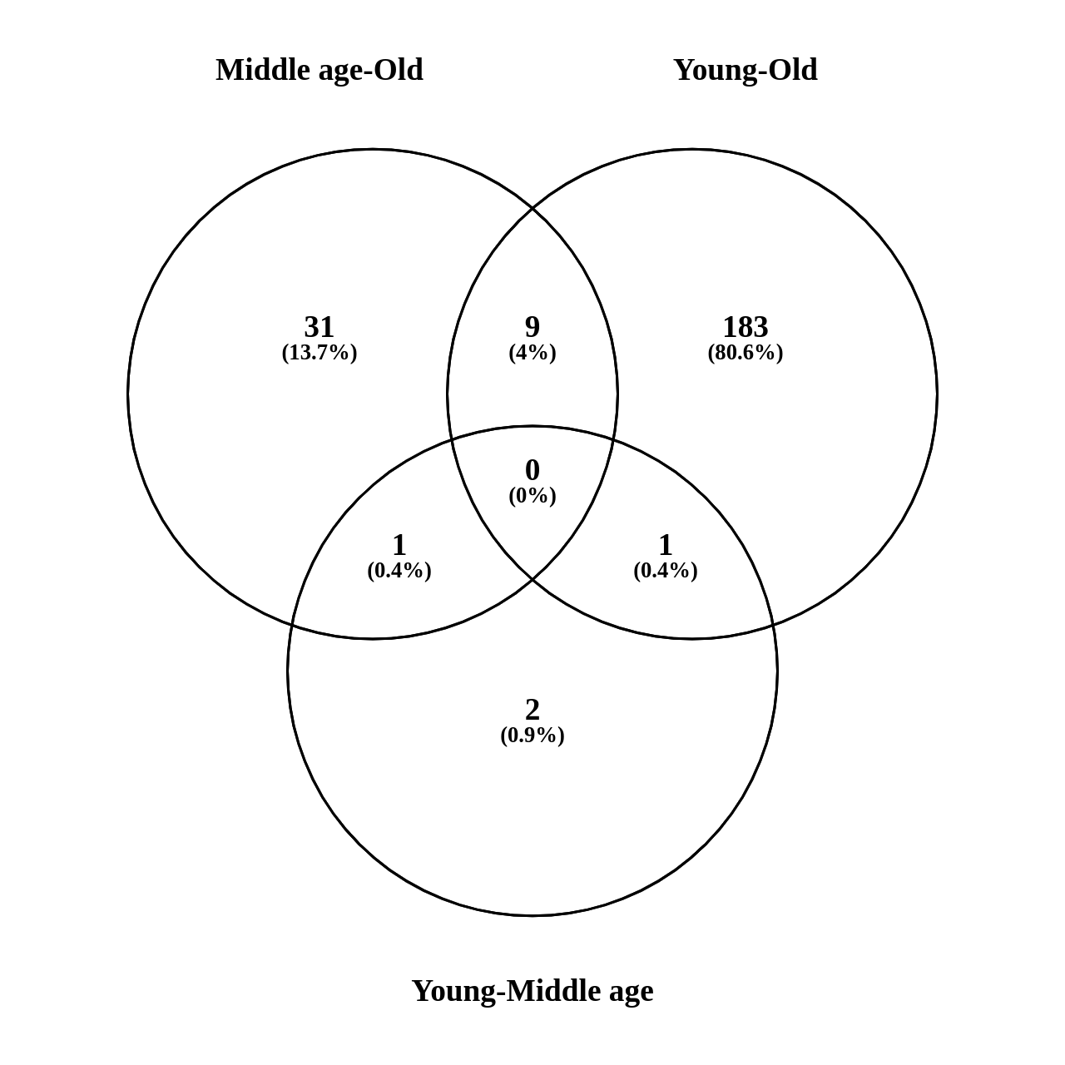
Differentially expressed genes
3
Experiment | Evaluation | Regulation | n Genes
GSE152558 | MO | UP | 8
GSE152558 | MO | Down | 9
GSE157585 | YO | UP | 9
GSE157585 | YO | Down | 73
GSE164471 | YO | UP | 5
GSE164471 | YM | UP | 2
GSE164471 | MO | UP | 6
GSE164471 | YO | Down | 8
GSE164471 | YM | Down | 2
GSE164471 | MO | Down | 11
GSE23527 | YO | Up | 1
GSE23527 | YO | Down | 5
GSE875105 | YO | Up | 88
GSE875105 | MO | Up | 6
GSE875105 | YO | Down | 18
YM – 4
MO – 40
YO – 207

Slide 21
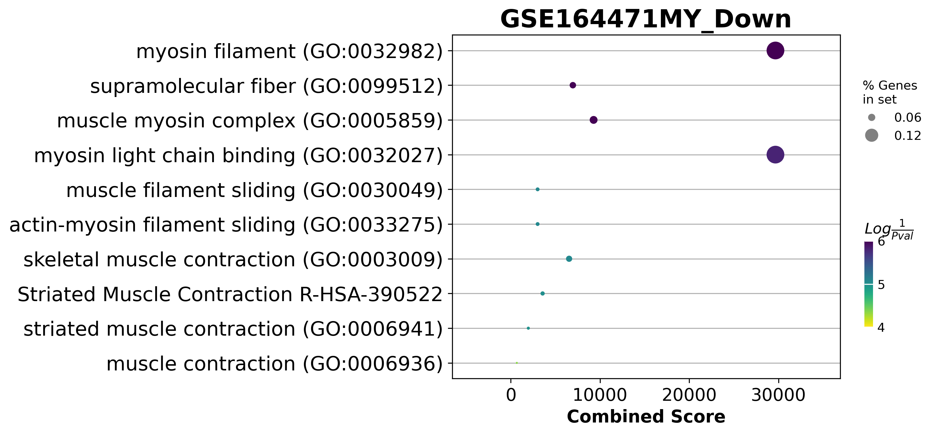
Young to middle age

Slide 22
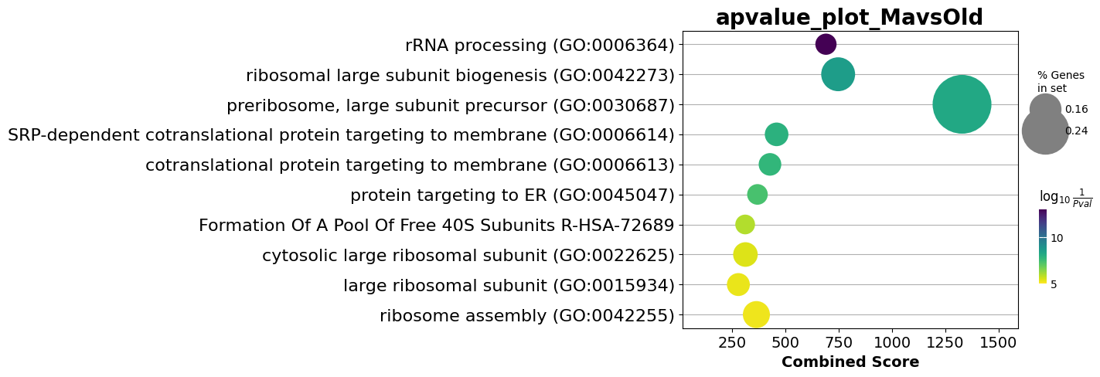
Middle age to old

Slide 23
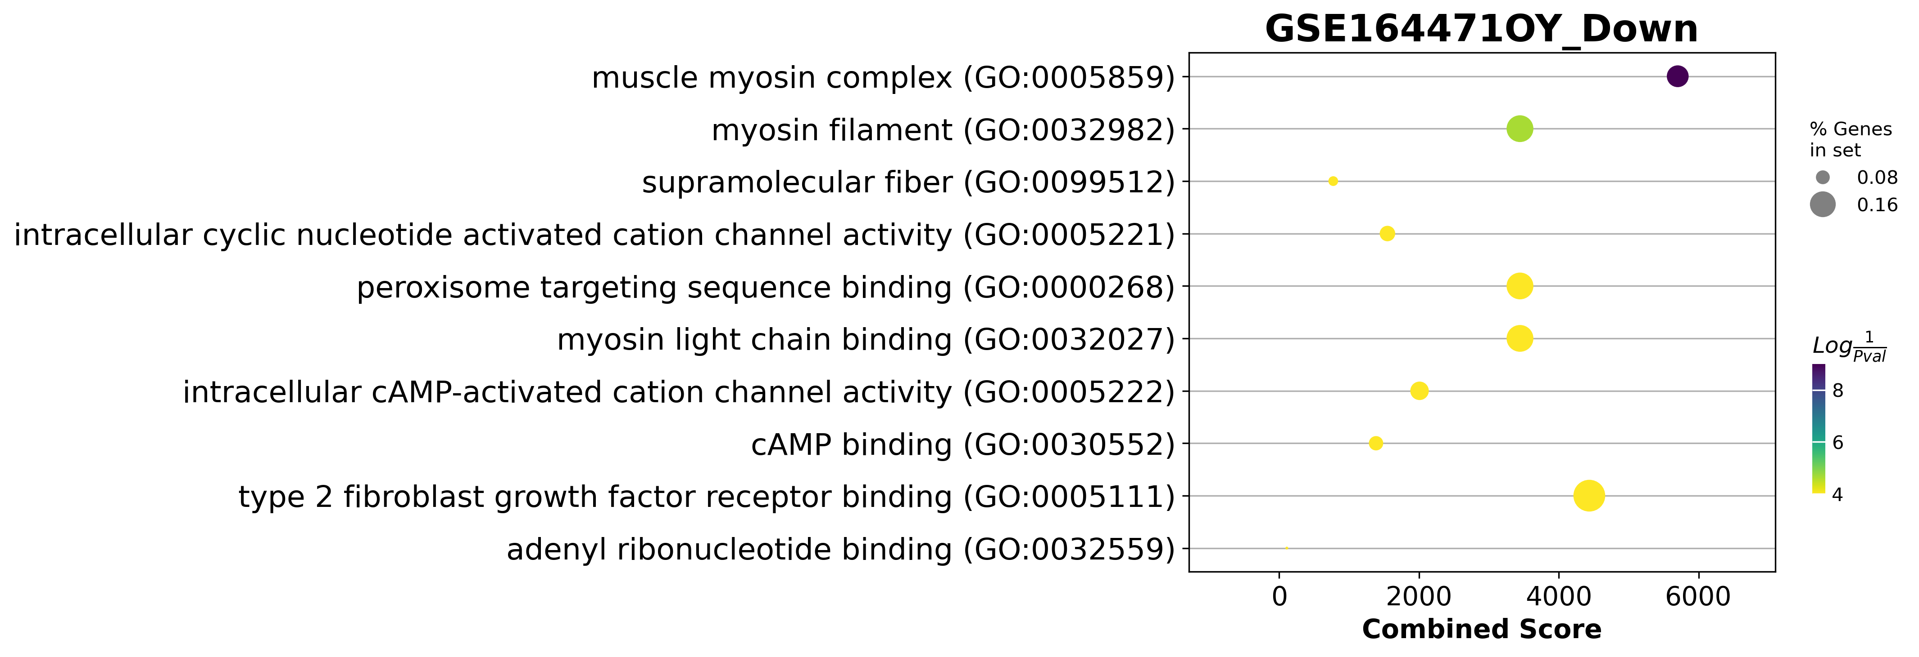
Young to old

Slide 24
miRKatDB: An integrated resource for microRNA data
4

Slide 25
Current resources
4
Database | year | Cites | PubmedID | Content | Prediction Algorithm | API | API alternative
miRBase | 2014 | 2368 | 24275495 | General | NA | NA | NA
miRWalk | 2011 | 830 | 21605702 | Predicted miRNA | Yes | NA | NA
miRTarBase | 2010 | 563 | 21071411 | General | NA | NA | NA
miRDB | 2020 | 374 | 31504780 | Expression | Yes | NO | Yes
DIANAmiTED | 2022 | 0 | 34469540 | Expression | NA | NA | NA

Slide 26
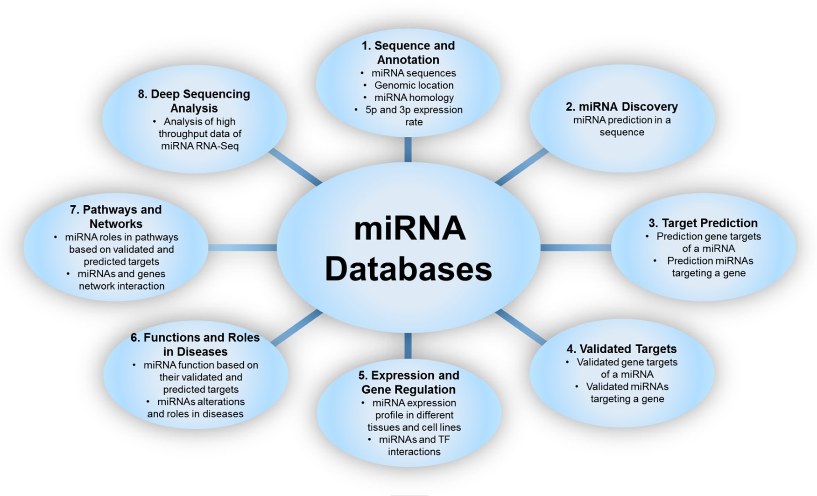
Classification of miRNA databases.
Aghaee-Bakhtiari, Seyed Hamid, Ehsan Arefian, and Pierre Lau. "miRandb: a resource of online services for miRNA research." Briefings in bioinformatics 19.2 (2018): 254-262.

Slide 27
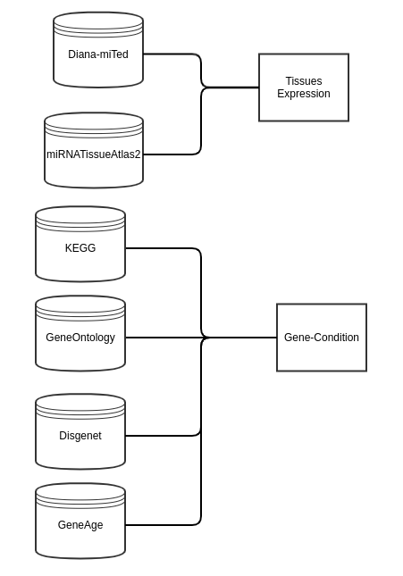
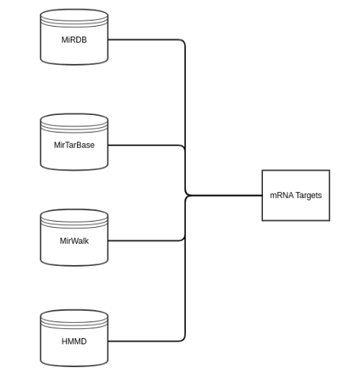
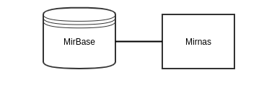
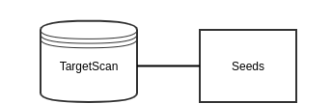
Collection structure
4

Slide 28
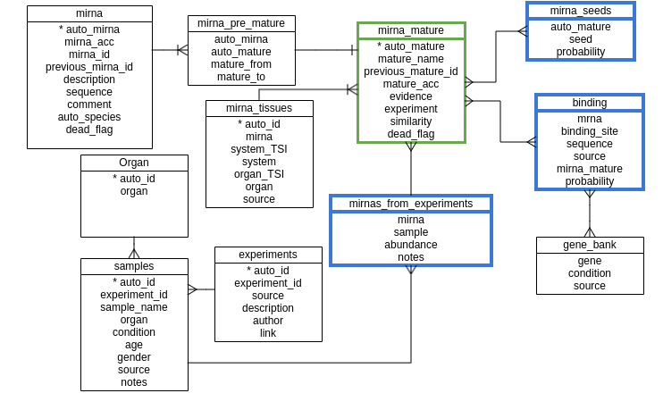
Database structure
4

Slide 29

Current status of miRKatDB
4
Hosted 49155 microRNAs
22,267,896 Interactions (including transcription factors)
8 Databases integrated
Hosted on CloudCIX on IP 185.175.171.169
2836.3 MB

Slide 30
Future work with the database
4
Add databases
MirGeneDB 2.0
MiREDiBase
Add expression and function if no API or alternatives found
Add API to the easy access of the database.
Add NLM to ask queries in natural language.
Complete documentation of the structure and queries

Slide 31
Network analysis
5

Slide 32
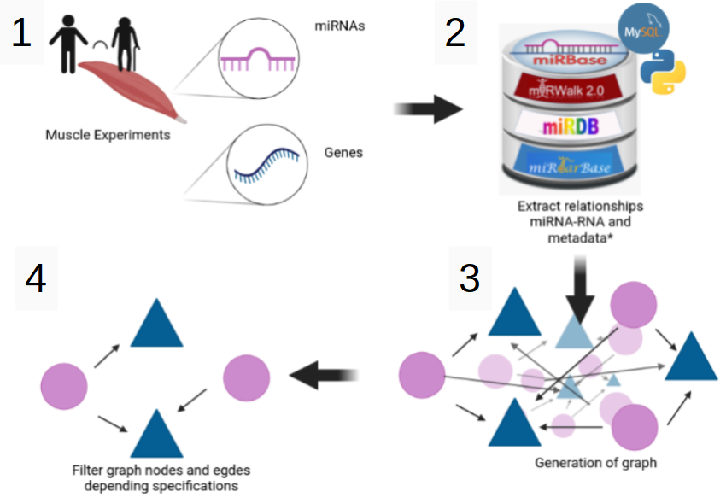
Integration of DE genes and microRNAs
5

Slide 33

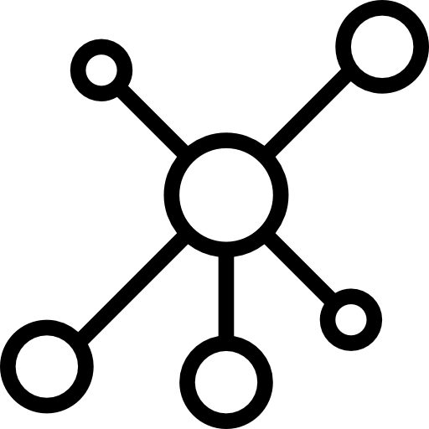
miRKat flow
5
Input
miRKat
Output

Slide 34

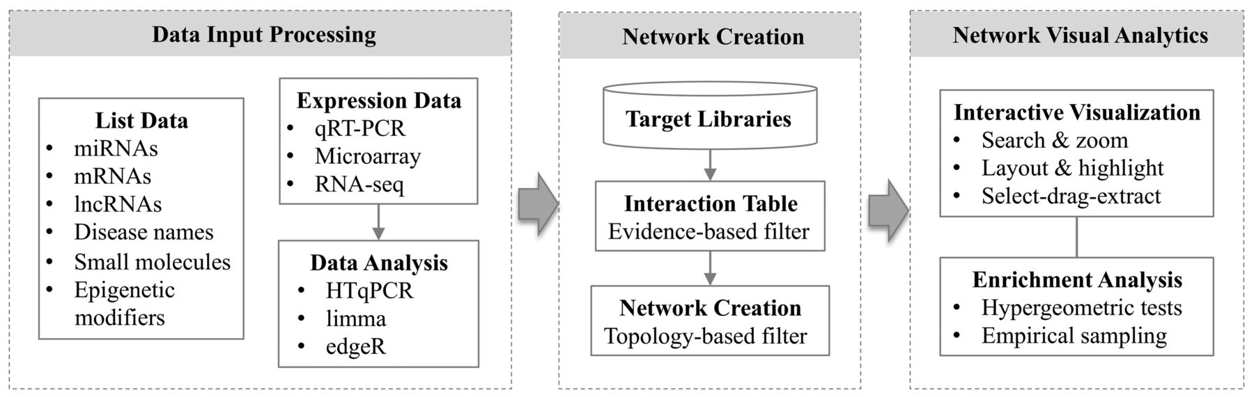
State of the art: miRNet
5
Fan, Yannan, et al. "miRNet-dissecting miRNA-target interactions and functional associations through network-based visual analysis." Nucleic acids research 44.W1 (2016): W135-W141.

Slide 35
Challenges
5
Selection of microRNAs
Bias on enrichment analysis
Inexistent microRNAs vs undiscovered microRNAs
Evaluation of the network

Slide 36
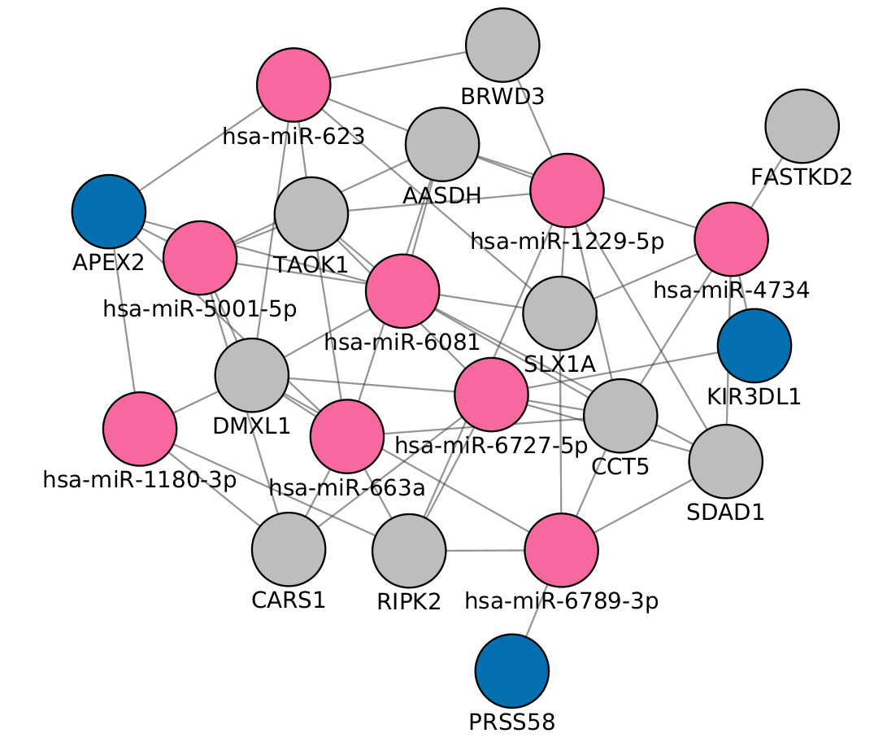
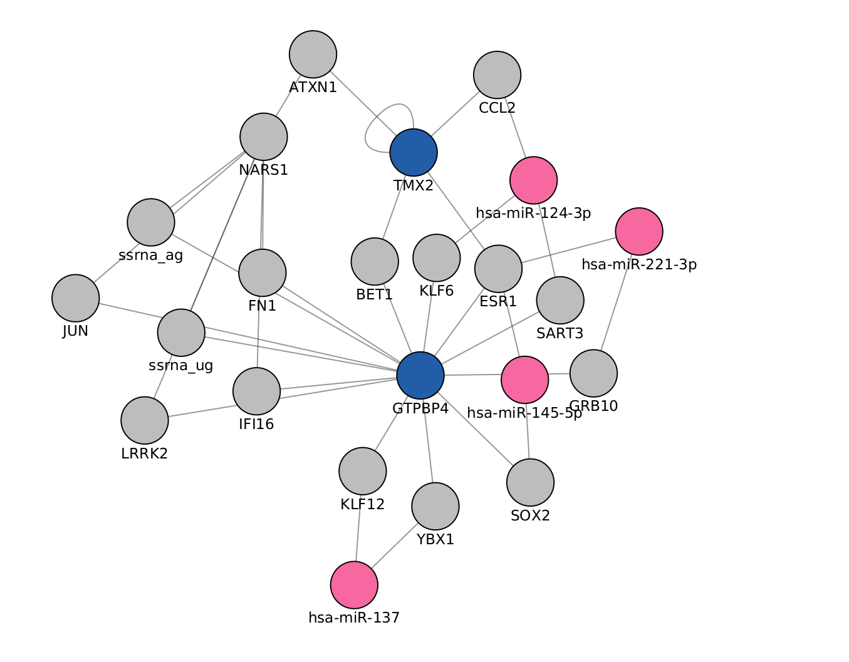
Approaches tangled
5
Evaluate microRNAs with different centralities:
Betweenness centrality
PageRank centrality

Slide 37
Future work
5
Score the networks
Machine learning base network prune
Combine the 3 timeframes on one network along time

Slide 38
Overview of future work
6

Slide 39
Future work
API for access on the Database and NLM
Score the networks
Selection of final Genes and MicroRNAs
Generation of model using selected elements in COPASI
Validation of the models.

Slide 40
Thank You

Slide 41
Acknowledgements
This presentation has emanated from research conducted with the financial support of Science Foundation Ireland under Grant number [18/CRT/6214 ]

